Slide 1
Towards Exploiting User-Centric Information for Proactive Caching in Mobile Networks ‡
Mobile Multimedia Laboratory
dept. of Informatics, Athens University of Economics and Business
Xenofon Vasilakos, Vasilios A. Siris, and George C. Polyzos {xvas, vsiris, polyzos}@aueb.gr
23-04-2012, WWRF28, Athens
Xenofon Vasilakos
‡ The work reported here was supported by the FP7 ICT project PURSUIT

Slide 2
User-Centric Information for Proactive Caching
Goal: Improve the quality of service offered by the network with respect to delay experienced by mobile users.
How: Track, understand and leverage a users’ context, preferences, and behavior to proactively cache information at users’ future network attachment points, thus reducing delay

Slide 3
User-Centric Information for Proactive Caching
Goal: Improve the quality of service offered by the network with respect to delay experienced by mobile users.
How: Track, understand and leverage a users’ context, preferences, and behavior to proactively cache information at users’ future network attachment points, thus reducing delay

Slide 4
Outline
Introduction
Selective Neighbor Caching (and extensions)
Conclusions

Slide 5
1. Introduction
Information Centric Networks
Tracking behavior, user preferences ..
Proactive Caching

Slide 6
Information-Centric Networks - ICNs (1/2)
Context and behavior determined based on the underlying network architecture
Users in ICNs issue subscription requests for desired information/content/items.
Explicitly declare interest to the network
Item popularities and user preferences and context
Subscriptions used to track or infer
Users’ mobility patterns estimated or predicted by past exhibited mobility behavior

Slide 7
Information-Centric Networks - ICNs (2/2)
ICNs are Mobile friendly compared to IP networks
Employ a receiver-driven model
Receivers request content by its name instead of an address/location, asynchronously
Connectionless (stateless) transport of content
contrary to TCP’s end-to-end stateful control involving location-dependent IP addresses

Slide 8
Why Proactive Caching ?
Improves QoS for delay sensitive applications
strict delay requirements for mobile subscribers
streaming multimedia services which are sensitive to delay jitter
Examples:
real-time emergency notification services,
teleconferencing,
online gaming
..
Also useful lossless transmission during the mobile’s disconnection period
E.g., document data transferring or event notification

Slide 9
Why Proactive Caching ?
Improves QoS for delay sensitive applications
strict delay requirements for mobile subscribers
streaming multimedia services which are sensitive to delay jitter
Examples:
real-time emergency notification services,
teleconferencing,
online gaming
..
Also useful lossless transmission during the mobile’s disconnection period
E.g., document data transferring or event notification

Slide 10
Proactive Caching
Proactive approaches^{[1..5]} trade-off buffer space for reduced delay in forwarding items to mobile subscribers
Mobility supported through proxies
Handle subscriptions on behalf of mobiles
Can proactively cache items for immediately serving mobiles upon attaching to them
Proactive caching items matching a mobile's subscriptions in single hop distance ``neighboring'' proxies, before mobile’s disconnection.

Slide 11
Selective Neighbor Caching (SNC)
SNC - The core idea
SNC plus users’ context and preferences
Some preliminary results

Slide 12
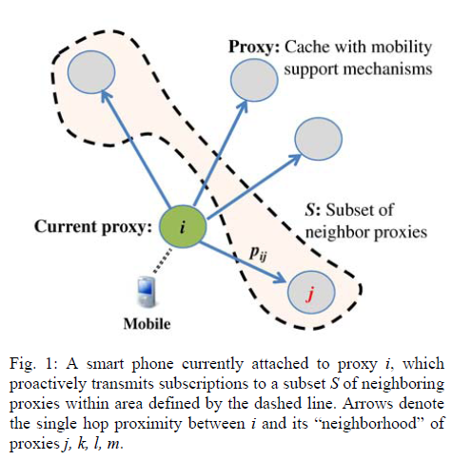
SNC - The core idea (1/2)
Selective Neighbor Caching^{[5]} is
A proactive caching solution
Fully decentralized_
Reduces overall delay experienced by mobiles
Uses only an appropriate subset of neighboring proxies => better use of buffer
Reducing combined buffering and delay costs as expressed by a target cost function:

Slide 13
SNC - The core idea (2/2)
SNC assumes Mobile transition probabilities Pij and Cost values for link delays and buffering allocation at caches of proxies.
Ccache at each proxy periodically reestimated after the current buffer availability determined by supply and demand.
Link costs in cases of cache misses and cache hits
Periodic delay measurements at neighboring proxies
or average delay costs
The appropriate delay metrics?
This is subject to the application requirements set
traffic congestion, link capacity, delays due to link latency as well as all the possible combinations

Slide 14
SNC plus users’ context and preferences (1/2)
Adding SNC extensions does not imply altering the fundamental SNC decision model
Average number of requests n_{k} for a certain item k
formed by the behavior of mobiles attached so far to a proxy i
The popularity of k used for the replication of popular items.
Proxy i can proactively cache subscriptions referring to k in a neighbor proxy j, after both transition probabilities for mobiles and the popularity of item k.

Slide 15
SNC plus users’ context and preferences (2/2)
Introduce Groups of mobiles on the basis of common context and preferences
E.g., users requesting for football videos are more likely to request for more items of the group “latest goals achieved”
Identified after a history of measurements
More precise estimation of mobile transition probabilities for each identified group g
Groups of items
Grouping of mobiles and grouping of items combined
Interestingly, enhances the QoS experienced by both mobile and fixed users.

Slide 16
Conclusions

Slide 17
Conclusions
User’s context and behavior is important
... and easy to determine and leverage with ICN
Information requests and mobility patterns can be exploited to proactively cache at the mobiles’ future network attachment point
Selective Neighbor Caching as an enhancement for seamless mobility and reduced delay QoS for mobiles.
Finally, we sketch how the core model of SNC can further adapt to mobile or fixed user-centric context, preferences, and behavior

Slide 18
References
A. Gaddah and T. Kunz, “Extending mobility to publish/subscribe systems using a pro-active caching approach”
I. Burcea,et al., “Disconnected operation in publish/subscribe middleware”
N. Golrezaei et al., “Femtocaching: Wireless video content delivery through distributed caching helpers”
F. Malandrino et al. “Proactive seeding for information cascades in cellular networks”
V. Siris et al., “A Selective Neighbor Caching Approach for Supporting Mobility in Publish/Subscribe Networks”

