Slide 1
Adapting Data Popularity in Mobility-Based Proactive Caching Decisions for Heterogeneous Wireless Networks
Xenofon Vasilakos, and Vasilios Siris, PhD student, AUEB, MMLAB mm.aueb.gr/~xvas xvas@aueb.gr
Notes:
Work in progress

Slide 2
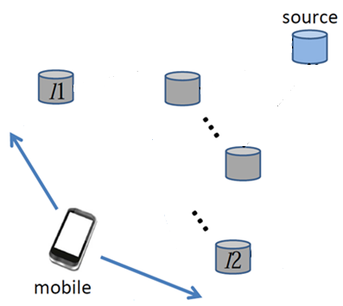
Problem
Reduce propagation delay
f(#network hops)
Notes:
I would like to start first with defining the problem we are trying to solve
This is a figure that shows a mobile
It is running delay sensitive applications
It also shows a set of future attachment points and a source of data

Slide 3
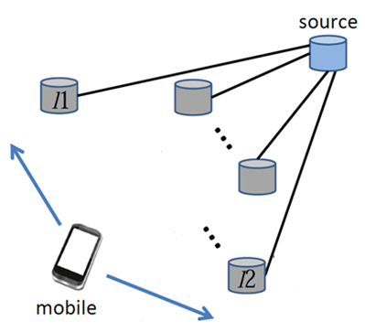
Approach
Proactively fetch data-objects to attachment points
Is this a typical proactive caching approach?
Notes:
In order to reduce distance, we proactively fetch and cache data
Users get data immediately after handoff
At this point you may be wondering if this a typical proactive caching approach

Slide 4
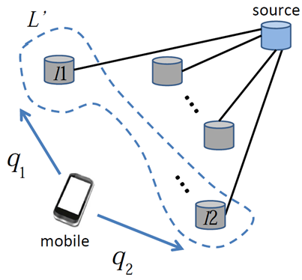
Efficient Proactive Caching - EPC
Handoff mobility probabilities
Exploit Individual
Mobility
Mobiles’ requests
Notes:
We exploit t knowledge on mobility (where it is going to attach next) and requests (what data the mobile is requesting)
In order to choose which caches do proactively fetch and cache data
We do not use popularities. They cannot help for applications such as mobile chat or notifications which are custom to mobile users

Slide 5
EPC-POP: EPC + Legacy Popularity
Exploit
Individual mobility & requests
Data-popularities for mobiles’ requests

Slide 6
Motivation for adding Legacy Popularity
EPC takes incremental decisions
Mobile connects to a caching point
Caching decisions for neighboring caching points
Mobile disconnects (handover)
Caching decisions are canceled
Why focus only on individual mobiles?
Some decisions may yield gain for more mobiles than other decisions
Because some objects requested are more popular
Why cancel decisions after a mobile handoffs?
Other mobiles may benefit from an already cached item

Slide 8
EPC decisions
Individual requests
Implies high demand for cache space
Congestion pricing for storage
Cache an object iff:
q: transition probability
D: delay cost gain from caching
p: price of the local buffer
Autonomous decisions at caching points
q ∙ D > p
> p
Notes:
We call it efficient proactive caching because
pricing utilizes cache efficiently, adapting to dynamic demand/supply conditions
thus it trades cache space (evaluated as a price) for reduced delay (cost)
Each cache decides autonomously using the rule, knowing only:
Delay in order to assess delay costs (e.g. periodic pinging)
Handoff mobility probs. (e.g. handoff history between APs, external mechanism)
Compute prices (internal to caches)

Slide 9
How to adapt popularity
Use probability and request frequency
f: probability that an object s is requested (i.e., the frequency of requests for an object)
w: number of object requests in one handoff interval
Q: probability of the mobile requestor
or the summary of probabilities of all requestors
(Q + w ∙ f) ∙ D > p
> p
Notes:
w: a weight which reflects demand ratio between mobiles connected to the caching point and mobiles requesting to proactively cache items to the caching point.
f: based either on temporal locality (i.e., local history of requests) or on a central service with up-to-date information about the popularity of requests.

Slide 10
How to adapt popularity
Use cache replacement
Do not evict proactively cached objects after a handoff
Keep objects which may benefit other mobiles
If (Q + w ∙ f) ∙ D > p, replace by evicting objects with minimum (Q + w ∙ f) ∙ D
Notes:
W: a weight which reflects demand ratio between mobiles connected to the caching point and mobiles requesting to proactively cache items to the caching point.

Slide 11
On going work on extending mobility based Efficient Proactive Caching with Legacy Popularity
Notes:
What we presented – take home message

