Slide 1



Small Cells and Device-to-Device Networks towards the 5G Era: Fundamentals,
Applications, and Resource Allocation using Game Theory
Vaggelis G. Douros George C. Polyzos
{douros,polyzos}@aueb.gr
http://mm.aueb.gr/
Tutorial at European Wireless 2015 Budapest, 20-05-2015
1

Slide 2
Introduction, Motivation, and Outline

Slide 3


Presenters
Vaggelis G. Douros
George C. Polyzos
Ph.D., AUEB, 2014
Research Interests
  Game Theory for Radio Resource Management in Wireless Networks
  5G (Small Cells, Device-to-Device Networks, Licensed Spectrum Sharing)
Ph.D., UofToronto, 1989
Prof., UCSD, 1988-1999
Prof., AUEB, 1999-present
Research interests
  Wireless Networks & Mobile Communications
  Information-Centric Networking
  Security & Privacy

Slide 4
Related Research Projects
Incentives-Based Power Control in Wireless Networks of Autonomous Entities with Various Degrees of Cooperation, Heraclitus II, 2011-2014
Weighted Congestion Games and Radio Resource Management in Wireless Networks, Basic Research Support Program, AUEB, 2011-12
CROWN: Optimal Control of Self-Organized Wireless Networks, General Secretariat of Research and Technology, Thales Project, 2012-2014
  http://crown-thales.uth.gr/

Slide 5
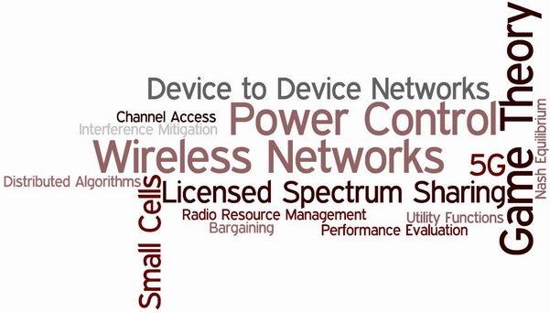
Related Research Topics

Slide 6


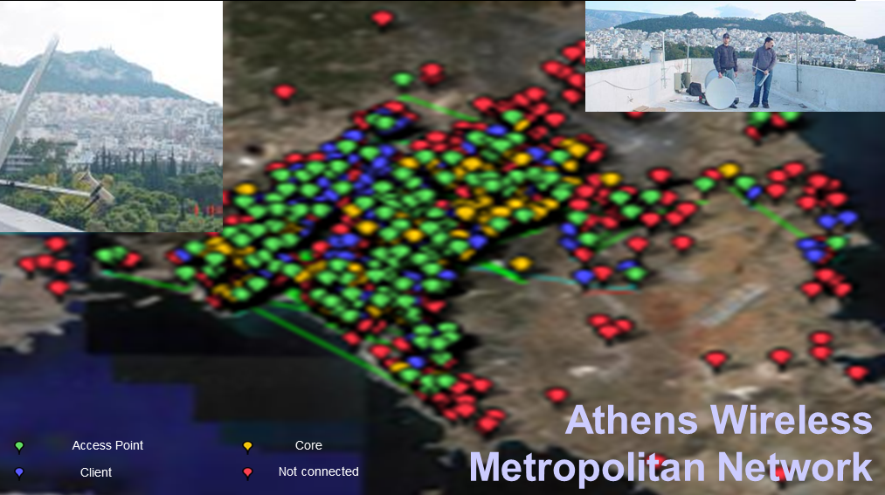
People
Faculty
  George C. Polyzos, Director
  Iordanis Koutsopoulos
  Giannis Marias
  George Xylomenos
  Vasilios Siris
  Stavros Toumpis
Senior Researchers/PostDocs
  Merkourios Karaliopoulos
  Nikos Fotiou
  Vaggelis G. Douros
Ph.D. Students
  Xenofon Vasilakos
  Yannis Thomas
  Charilaos Stais
  Christos Tsilopoulos
MSc students
Researchers
Undergraduate students
http://mm.aueb.gr/

Slide 7
MMLab: other Research Areas
  Future Internet Architecture
    Information-Centric Networking
  The Internet of Things
  Network Security
  Privacy

Slide 8
FP7 Research Projects
  EIFFEL: Evolved Internet Future For European Leadership (SSA)
  Euro-NF: Anticipating the Network of the Future-From Theory to Design (Network of Excellence)
    (Internal) Specific Joint Research Projects
      ASPECTS: Agile SPECTRum Security ()
      GOVPIMIT: Governance & Privacy Implications of the ‘Internet of Things’
      E-Key-Nets: Energy-Aware Key Management in Mobile Wireless Sensor Networks
  PSIRP: Publish-Subscribe Internet Routing Paradigm (STREP)
  PURSUIT: Publish-Subscribe Internet Technology (STREP)

Slide 9




I-CAN: Information-Centric future mobile and wireless Access Networks
a revolution in mobile Internet usage
  massive penetration of smartphones and mobile social networks
Information-Centric Networking (ICN)
  decouples data (service) from devices storing (providing) it through location-independent naming
    a fundamental departure from the Internet’s host-centric communication model
  towards an architecture matching the currently dominant network usage:
    users exchanging information independently of the device that provides it
  D2D, multihoming etc.
I-CAN will
  develop an ICN architecture integrating mobile and Wi-Fi access technologies
  utilize mobility and content prediction in ICN, together with proactive caching, offloading mobile traffic to Wi-Fi
    capturing the tradeoffs between the delay, energy consumption, amount of offloaded traffic, privacy, and cost;
  design procedures for efficient data collection and dissemination,
    in-network caching, multicast, and multipath/multisource content transfer.
information-centric prototype implementation
  experimentally evaluated

Slide 10
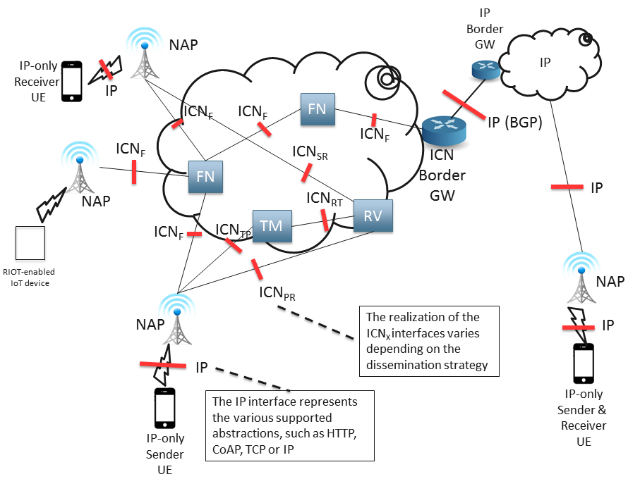
  POINT: IP Over ICN - The Better IP?
  H2020 STREP 1/1/2015-31/12/2017
Concept
  Premise: IP apps can do better over ICN
    Need to define what “better” means
Focus
  1 provider/ISP
  UE: no changes (required)
  ICN used internally in the network
  ICN could be exposed to UE

Slide 11
Tutorial Objectives (1)
To present the latest research and industrial activities in 5G networks
To present an overview of the current status in small cells and device-to-device (D2D) networks
  with emphasis on their real world applications

Slide 12
Tutorial Objectives (2)
To highlight key resource allocation approaches (power control, rate adaptation, medium access,and spectrum access) in these types of wireless networks
  using (non-)cooperative game theory
To introduce the concept of licensed spectrum sharing and study it under the prism of game theory

Slide 13
Outline
Part I: Towards the 5G Era
Part II: Small Cells
Part III: Device-to-Device (D2D) Communications
Part IV: Game Theoretic Approaches for Resource Allocation in Modern Wireless Networks
Part V: Licensed Spectrum Sharing Scenarios
Part VI: Conclusions

Slide 14
Towards the 5G Era

Slide 15
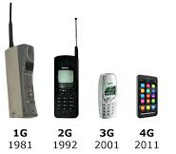
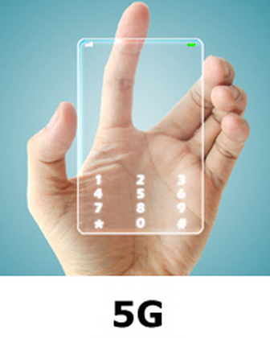
Towards the 5G Era (1)
 | 4G | 5G
Year | 2010 | 2020-2030
Standards | LTE, LTE-Advanced | -
Bandwidth | Mobile Broadband | Ubiquitous connectivity
Data rates | xDSL-like experience: 1 hr HD-movie in 6 minutes | Fiber-like experience: 1 hr HD-movie in 6 seconds
 | 4G
Year | 2010
Standards | LTE, LTE-Advanced
Bandwidth | Mobile Broadband
Data rates | xDSL-like experience: 1 hr HD-movie in 6 minutes
15
FIA, Athens, March 2014

Slide 16
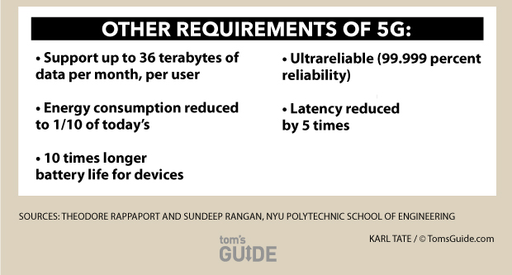
Towards the 5G Era (2)

Slide 17
Towards the 5G Era (3)
Mobile Devices
Evolution of communication paradigms
Mobile Data Traffic
Data by Cisco, Forecast 2013-2018
17
Notes:
17

Slide 18
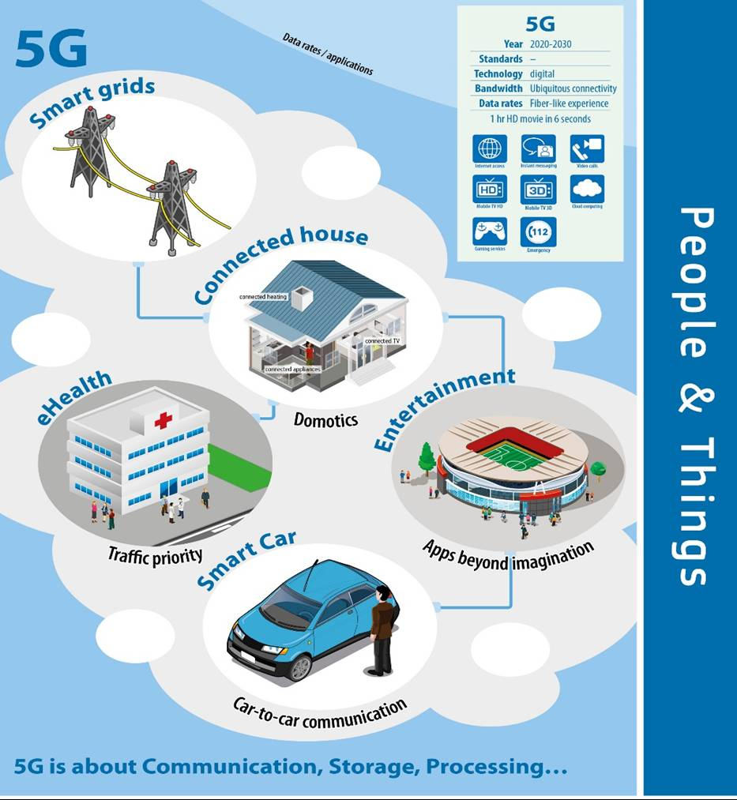
Applications

Slide 19
Key Communication Paradigms (1)
Picocell
Multi-tier small cell networks
  Low(er)-power devices
Device-to-Device (D2D) communications
19

Slide 20

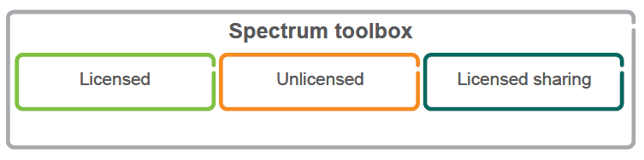
Key Communication Paradigms (2)
2013→2018
# Devices: 1.5x
# Data traffic: 10x
Spectrum?
Traditional spectrum availability is scarce
Bridging the spectrum gap
with 5G

Slide 21
Key Communication Paradigms (3)
Not covered in this tutorial
mm wave communications (30 to 300 GHz)
  Low interference promotes dense communication links for more efficient spectrum reuse
Massive MIMO systems
  huge improvements in throughput and energy efficiency via a large number of antennas
Cognitive radio technology
Fiber
…

Slide 22
Key Design Objectives
Implementation of massive capacity and massive connectivity
Support for an increasingly diverse set of services, applications and users
  all with extremely diverging requirements
Flexible and efficient use of all available non-contiguous spectrum for different network deployment scenarios

Slide 23
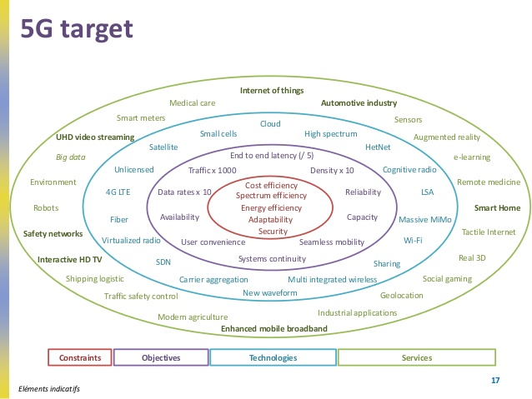
23
Source: Future Networks-Bernard Celli, ANFR, Digiworld 2014
Notes:
23

Slide 24
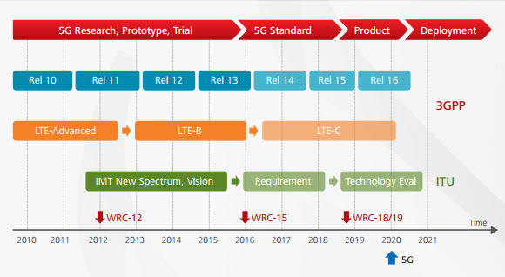
An Indicative 5G Timeline
Source: http://cse.ucsd.edu/node/2668

Slide 25
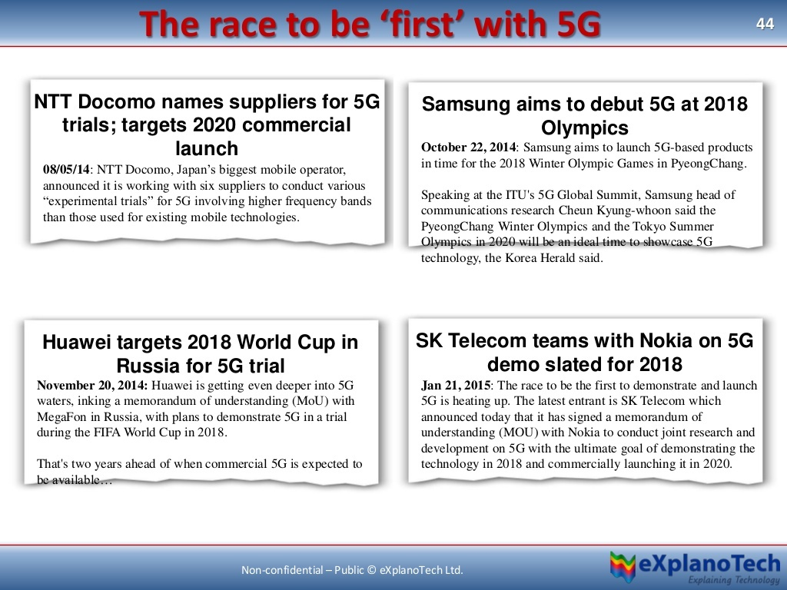

Slide 26
Some 5G Trials
[July 2014] Ericsson 5G delivers 5 Gbps speeds
  in the 15 GHz frequency band
  http://www.ericsson.com/news/1810070
[October 2014] Record-breaking 1.2 Gbps data transmission at over 100 km/h, and 7.5 Gbps in stationary conditions using 28 GHz spectrum
  Samsung 5G vision
[March 2015] DOCOMO's 5G Outdoor Trial Achieves 4.5 Gbps Ultra-high-speed Transmission
  in the 15 GHz frequency band
  https://www.nttdocomo.co.jp/english/info/media_center/pr/2015/0302_03.html

Slide 27
Small Cells

Slide 28
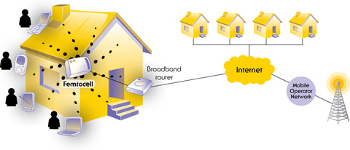
Definition
Operator-controlled, low-power access points
Source: small cell forum-http://www.smallcellforum.org/

Slide 29
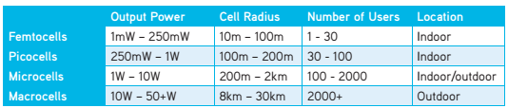
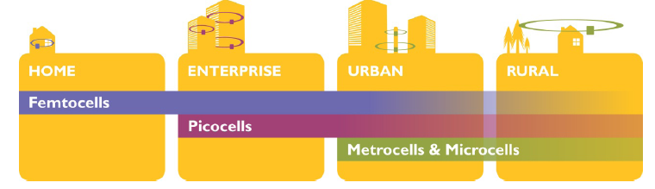
Types & Use Cases (1)
(Femto-Pico-Metro-Micro)Cells
From 10 meters to several hundred meters
Source: small cell forum

Slide 30
Types & Use Cases (2)
Home
  Indoors, a single small cell is usually sufficient
Enterprise
  generally indoor, premises-based deployment beyond home office
Urban
  Outdoors, in areas of high demand density
  indoor public locations such as transport hubs
Rural
  Coverage for underserved community, emergency services etc.

Slide 31
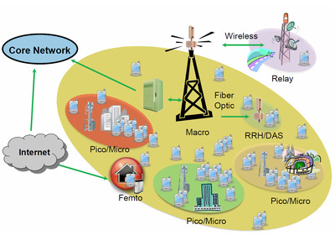
Heterogeneous Network
Definition: a mixture of small cells, macrocells and in some cases Wi-Fi access points
Source: http://www.radiocomms.com.au/content/test-measure/article/the-rf-challenges-of-lte-advanced-1190026497
Notes:
Figure 1.2 small cells, big ideas

Slide 32
Advantages
Support for all 3G handsets/most LTE devices
Operator-managed QoS
Seamless continuity with macrocells
  traditional cells
Ease of configuration
Improved security and battery life

Slide 33
A Classification
Zahir et al., Interference Management in Femtocells, IEEE S&T, 2014

Slide 34
Technical Considerations (1)
Interference management
  More cells… more interference
  Radio resource management techniques
Source: small cell forum

Slide 35
Some Technical Considerations (2)
Mobility management
  Seamless handovers to and from small cells to provide continuous connectivity
Open access vs. closed vs. hybrid
  Which devices have access to a small cell?

Slide 36
Shipments (1)

Slide 37
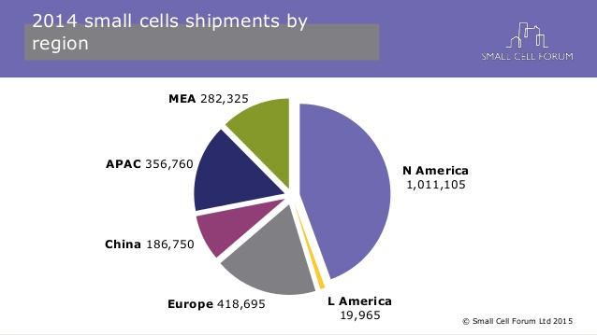
Shipments (2)

Slide 38
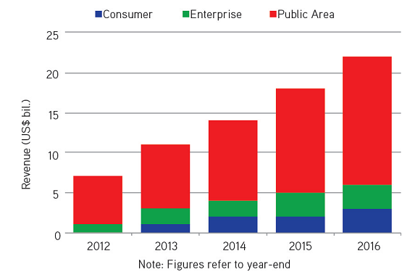
Global Small Cell
Revenue Forecasts
38

Slide 39
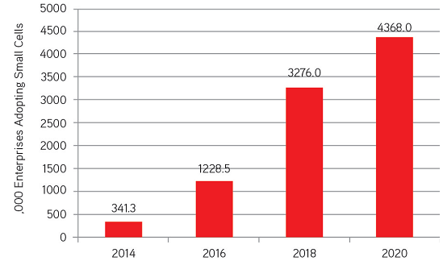
Number of Enterprises Potentially Adopting Small Cells 2014 to 2020
39

Slide 40
Small Cells vs. Wi-Fi:
Friends or Foes? (1)
Small Cells strengths:
  work with all 3G handsets
  provide seamless service continuity with the macro network
  need no configuration or special settings in the handset
  operate in licensed spectrum, allowing the operator to provide a managed service and maintain control of QoS
  do not require use of a second radio on the handset, thereby preserving phone battery life

Slide 41
Small Cells vs. Wi-Fi:
Friends or Foes? (2)
Wi-Fi strengths:
  low cost
  operator independence
Our position: Small Cells and Wi-Fi are expected to coexist harmonically
  Devices should be intelligent enough to optimally select the most appropriate connection
  (?) How to combine them in a cost-effective way?

Slide 42
D2D Communications

Slide 43
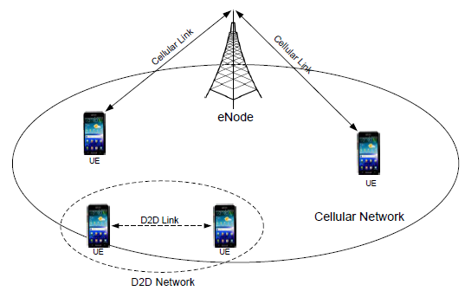
Definition
Source: S. Choi, “D2D Communication: Technology and Prospect,” 2013
D2D communication in cellular networks is defined as direct communication between two mobile users without traversing the Base Station or core network

Slide 44
(Potential) Advantages (1)
Reduced device transmission power
Reduced communication delay
  Device can communicate with neighbor device
Cellular traffic offload
  Enhanced cellular capacity
  Better load balancing
Increased spectral efficiency
  Spatial reuse through many D2D links
Extended cell coverage area
Easy support of location based service

Slide 45
(Potential) Advantages (2)
Capacity gain: due to the possibility of sharing spectrum resources between cellular and D2D users
User data rate gain: due to the close proximity and potentially favorable propagation conditions high peak rates may be achieved
Latency gain: when devices communicate over a direct link, the end-to-end latency may be reduced
Similarities with small cells

Slide 46
Applications (1)
Asadi et al., IEEE S&T, 2014

Slide 47
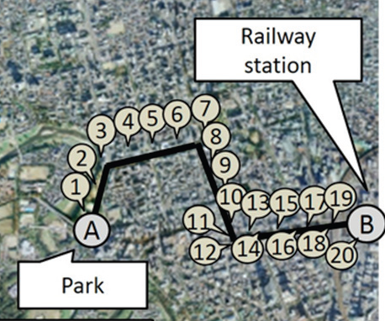
Applications (2)
Proximal communication – D2D scenarios
Realizing D2D ad hoc networks
Relay by smartphones, Japan trials
  [Nishiyama et al., IEEE Communications Magazine, 2014]
  https://www.youtube.com/watch?v=JbxKPrPF6JQ
47

Slide 48
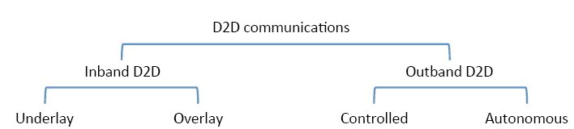
Classification (1)
Inband: use of cellular spectrum for both D2D and cellular links
Outband: D2D links exploit unlicensed spectrum
Asadi et al., “A Survey on Device-to-Device Communication in Cellular Networks”, IEEE S&T, 2014

Slide 49
Classification (2)
Inband: use of cellular spectrum for both D2D and cellular links
  Underlay: same radio resources
  Overlay: dedicated radio resources
Outband: D2D links exploit unlicensed spectrum
  Controlled: The cellular network controls the D2D communication
  Autonomous: the opposite

Slide 50
Classification (3)
Asadi et al., IEEE S&T, 2014

Slide 51
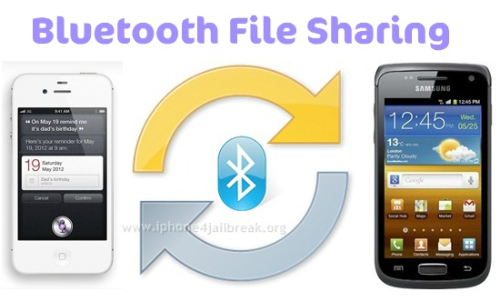
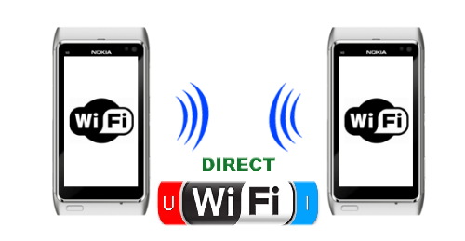
Bluetooth & Wi-Fi Direct
Applications of D2D
Bluetooth…
Wi-Fi direct: doesn't need a wireless access point
  official standard
  Wi-Fi without the internet bit
http://www.iphone4jailbreak.org/
www.arageek.com

Slide 52
Wi-Fi Direct (& Bluetooth) Shortcomings…
…for mass market deployment
Use of unlicensed spectrum
  Uncontrolled interference
Manual pairing
Low range
Independence of cellular network
  Drain for the batteries

Slide 53
LTE-Direct (1)
3GPP Release 12, Qualcomm
An autonomous, “always on” proximal discovery solution
Enables discovering thousands of devices and their services in the proximity of ~500m, in a privacy sensitive and battery efficient way

Slide 54
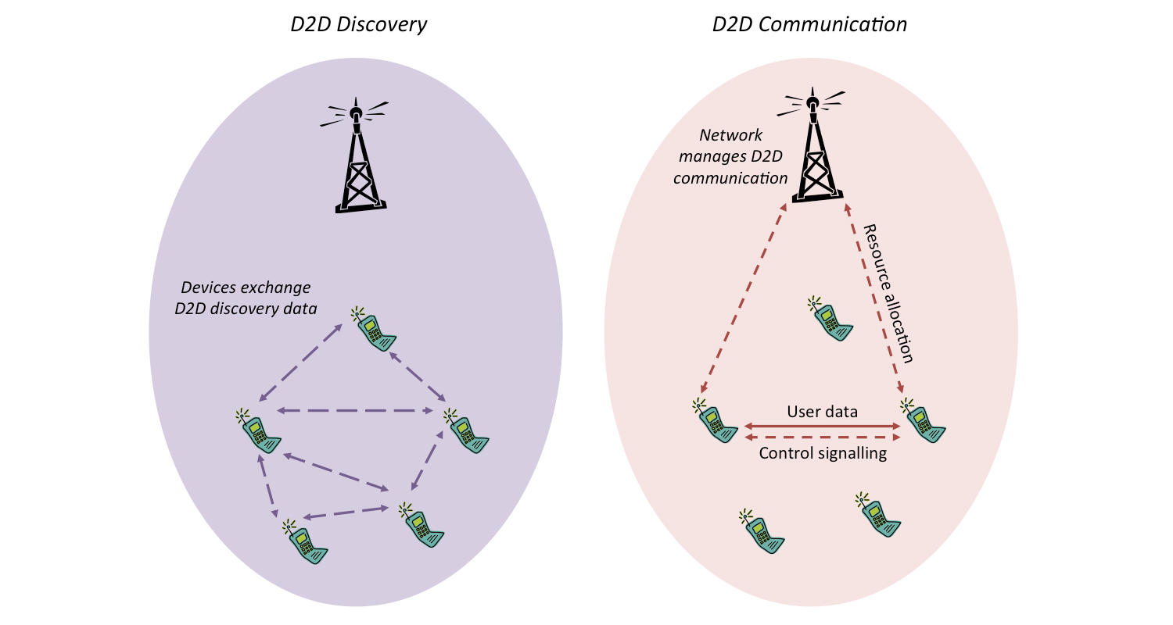
LTE-Direct (2)
D2D Discovery
D2D Communication
http://www.unwiredinsight.com/2014/lte-d2d

Slide 55
Radio Resource Management Using Game Theory

Slide 56
The Challenge
The fundamental challenge: Seamless coexistence of autonomous devices that share resources in such heterogeneous networks
The fundamental target: To design efficient distributed radio resource management (power control, channel access) schemes to meet this challenge

Slide 57



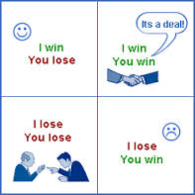
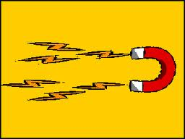
The Tools
1994 ←Nobel Econ.→2014
Grand Bazaar, Istanbul
Power control

Slide 58
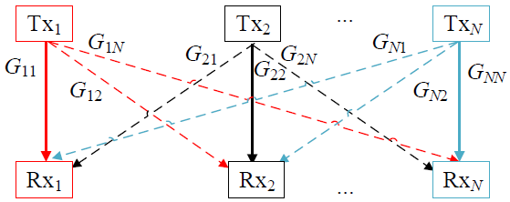
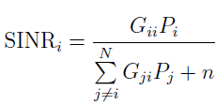
Roadmap (1)
Competition for resources among players
=(non-cooperative) game theory
Players | Devices
Strategy | At what power? When to transmit?
Utility | U_{i}(P_{i},SINR_{i})

Slide 59
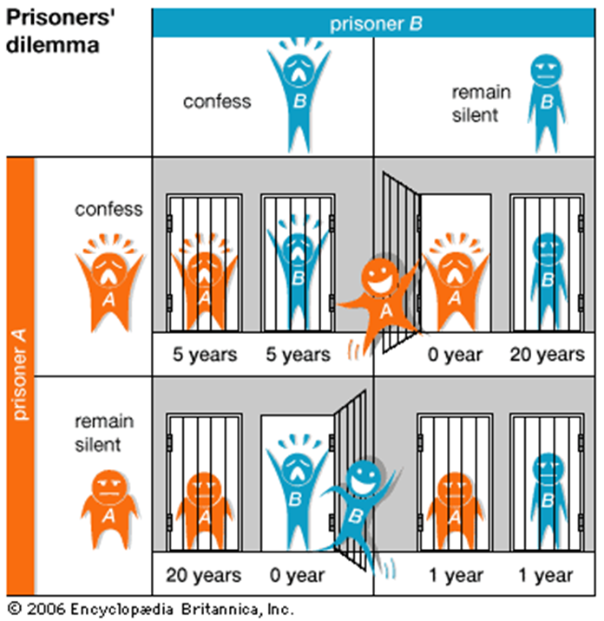
Roadmap (2)
Key question/solution concept:
Does the game have a Nash Equilibrium (NE)?
How can we find it?
Is it unique? If not, which to choose?
Is it (Pareto) efficient?
Incentives to end up at more efficient operating points

Slide 60
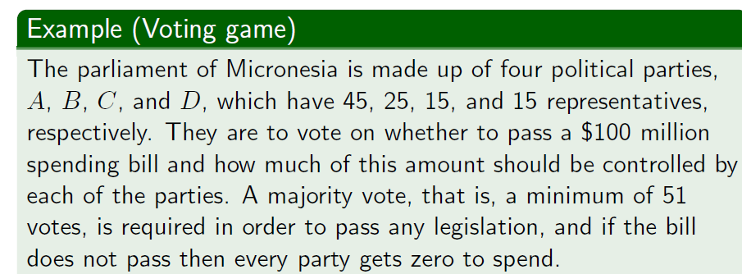
Roadmap (3)
via Kevin Leyton-Brown, Game Theory @UCSB
Which coalition should be formed?
How should the coalition divide its payoff?
  in order to be fair (e.g., Shapley value)
  in order to be stable (e.g., core)

Slide 61
A Classification of
Power Control Approaches
2G (Voice)
3G/4G (Data)
SIR-Based
[Zander 92]
SINR-Based
[F&M 93]
[Bambos 98]
Utility without cost part
[Saraydar 02]
Utility with
cost part
[Alpcan 02]
V.G. Douros and G.C. Polyzos, “Review of Some Fundamental Approaches for Power Control in Wireless Networks,” Elsevier Computer Communications, vol. 34, no. 13, pp. 1580-1592, August 2011.

Slide 62
Radio Resource Management in
Small Cells/D2D Networks
We will discuss radio resource management approaches in small cells/D2D networks
Roadmap:
  Description of the type of the wireless network, the resource allocation method and the networking target
  presentation of the game-theoretic model
  key idea of the algorithm/proposed solution
  the most interesting result

Slide 63
Power Control under Best Response Dynamics for Interference Mitigation in a Two-Tier Femtocell Network
  V.G. Douros, S. Toumpis, and G.C. Polyzos, RAWNET, 2012

Slide 64
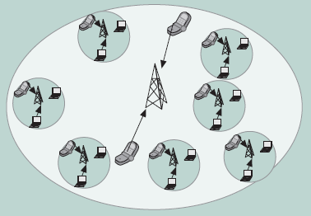
System Setup
A two-tier small-cell network
Chandrasekhar et al., IEEE Comm. Mag., 2008

Slide 65
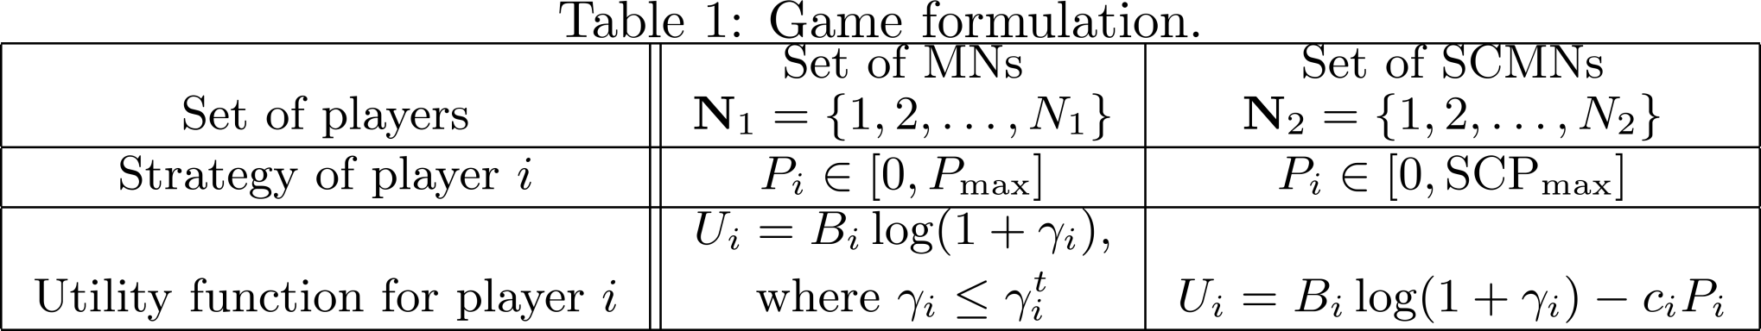
Problem Statement (1)
Players ←→N₁ Macrocell Mobile Nodes (MNs), N₂ Small Cell Mobile Nodes (SCMNs)
Strategy ←→Selection of the transmission power
  MN: P_{i} ∈ [0,P_{max}]
  SCMN: P_{i} ∈ [0,SCP_{max}]
Utility function…

Slide 66
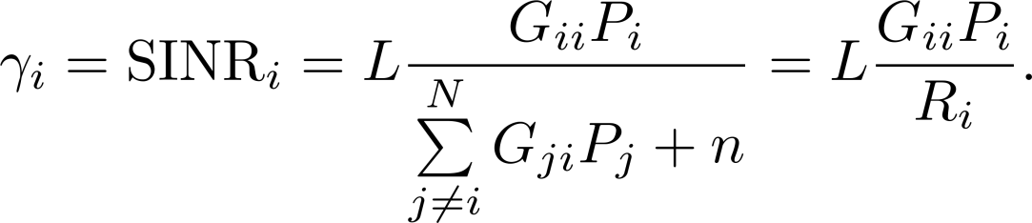
Problem Statement (2)
MN Utility: throughput-based
SCMN Utility: throughput minus a linear pricing of the transmission power

Slide 67
Problem Statement (3)
N₁ MNs
  will be mostly used for voice, inelastic traffic
  high(er) priority to be served by the operators
  use any transmission power up to P_{max} without pricing
  low(er) QoS demands (than small cells)
  SINR_{max}
N₂ SCMNs
  SCMNs should not create high interference to MNs
  pricing is used to discourage them from creating high interference to the macrocell users
  focus on data services→high(er) QoS demands
  No SINR_{max}

Slide 68
Contributions
We show that the game has at least one NE
We propose a distributed scheme to find a NE
  Using best responses
We derive conditions for the NE uniqueness

Slide 69
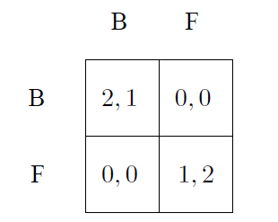
Best Responses
If column player plays B
  the best response of row player is B
If column player plays F
  the best response of row player is F
If row player plays B/F, the best response of row player is B/F
Using them, we can find the NE

Slide 70
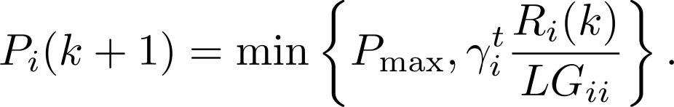
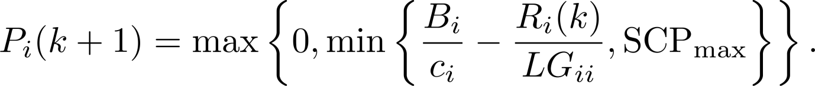
Analysis (1)
Best Response Dynamics Scheme
F&M, [TVT,1993]

Slide 71
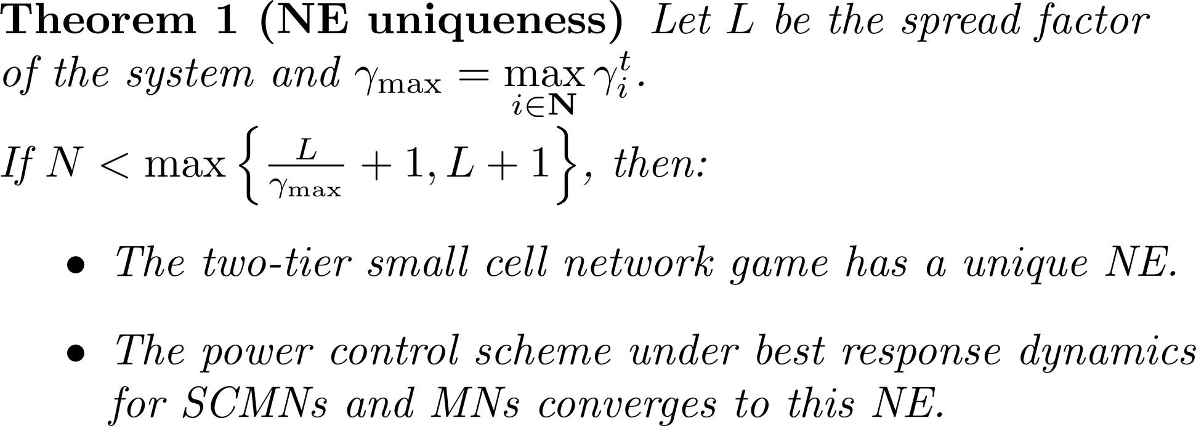
Analysis (2)

Slide 72
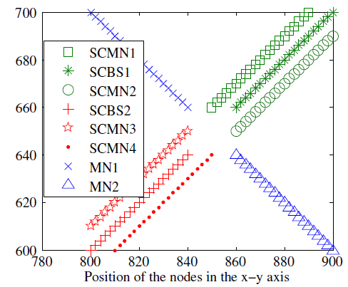
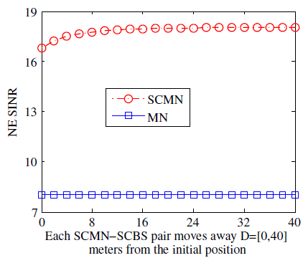
Some Results
Small Cell Forum/3GPP parameters
Efficient coexistence at the NE

Slide 73
Price-Based Resource Allocation for Spectrum-Sharing Femtocell Networks: A Stackelberg Game Approach
  Xin Kang, Rui Zhang, Mehul Motani, IEEE Journal on Selected Areas in Communications, 2012

Slide 74
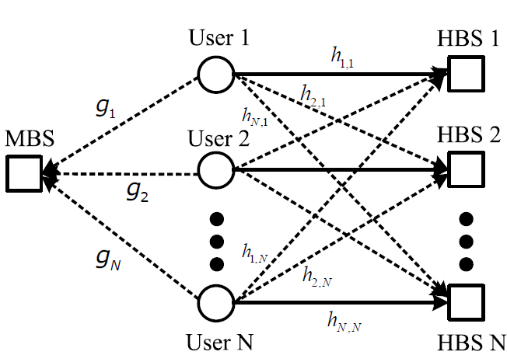
System Setup

Slide 75
Problem Statement (1)
1 macrocell BS, N small cells, uplink
The maximum interference that the MBS can tolerate is Q
  the aggregate interference from all the small cell users should not be larger than Q
  to protect itself through pricing the interference from the small cell users

Slide 76

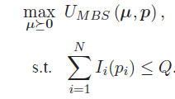
Problem Statement (2)
the MBS’s objective is to maximize its revenue obtained from selling the interference quota to small cell users
  μ: interference price vector, p: power vector

Slide 77



Problem Statement (3)
The utility for small cell user i
  λi is the utility gain per unit transmission rate

Slide 78
Stackelberg Game (1)
These optimization problems form a Stackelberg game
  1 leader (MBS)-N followers (small cells) game
Solution concept: Stackelberg Equilibrium (SE) point(s)
  neither the leader (MBS) nor the followers (small cell users) have incentives to deviate at the SE

Slide 79
Stackelberg Game (2)
Sequential game
The MBS (leader) imposes a set of prices on per unit of received interference power from each small cell user
Then, the small cell users (followers) update their powers to maximize their individual utilities based on the assigned interference prices
Does the game admit a SE? Can we find it?

Slide 80
Sparsely Deployed Scenario (1)
The mutual interference between any pair of small cells is negligible and thus ignored
(+) We can get complex closed-form price and power allocation solutions for the formulated Stackelberg game
Two approaches: uniform pricing vs. non-uniform pricing

Slide 81
Sparsely Deployed Scenario (2)
non-uniform pricing scheme
  A unique SE exists that maximizes the revenue of the MBS
  (-) must be implemented in a centralized way
uniform pricing scheme
  A unique SE exists that maximizes the sum-rate of the small cell users
  (+) can be implemented in a decentralized way

Slide 82
Densely Deployed Scenario
The mutual interference between small cells cannot be neglected
In general, there are multiple SE and it is NP-Hard to get the optimal power allocation vector
  For special cases (e.g., fixed interference from the small cells), we may derive complex closed-form formulas as well

Slide 83
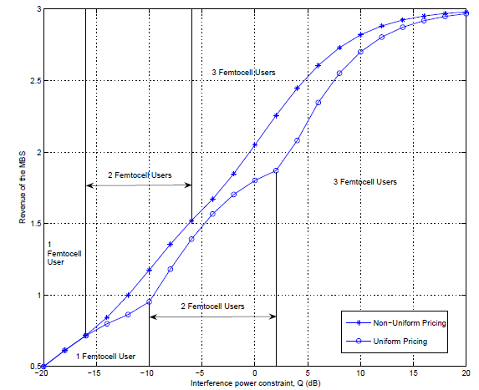
Revenue of the MBS vs. Q
Revenue vs. Q

Slide 84
Discussion
1 BS, 3 small cells
For the same interference constraint Q:
  the revenue of the MBS under the non-uniform pricing scheme is in general larger than that under the uniform pricing scheme
  the reverse is generally true for the sum-rate of small cell users
For small Q:
  the revenues of the MBS and the sum-rates become equal for the two pricing schemes
  only one small cell active in the network

Slide 85
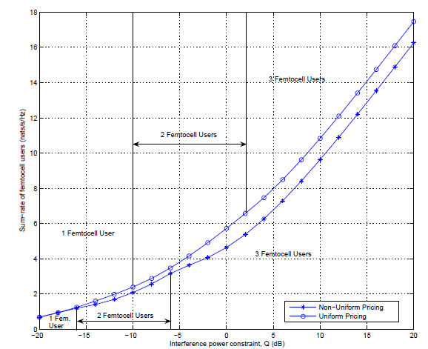
Sum-rate of femtocell users vs. Q
Sum Rate vs. Q

Slide 86
A College Admissions Game for Uplink User Association in Wireless Small Cell Networks
  Walid Saad, Zhu Han, Rong Zheng, Merouane Debbah, H. Vincent Poor, IEEE INFOCOM, 2014

Slide 87
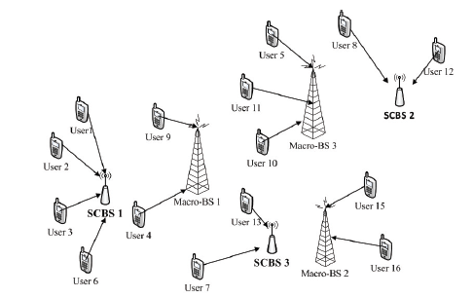
System Setup

Slide 88

Problem Statement (1)
M BSs, K outdoor SCBSs, N users, uplink
Each SCBS has a fixed quota on the number of users it can serve
No intra-access point interference
Each user i wants to maximize its probability of successful transmission and its perceived delay
R-factor captures Packet Success Ratio (PSR) p and delay τ

Slide 89
Problem Statement (2)
Each SCBS k has two objectives:
  to offload traffic from the macrocell, extend its coverage, and load balance the traffic
  to select users that can potentially experience a good R-factor
  Utility function:
  ρim is the PSR from user i to its best macro-station m
Each BS m uses a utility which is an increasing function of the PSR
The problem: How to assign users to (SC)BSs?

Slide 90
A College Admissions Game for Access Point Selection
the set of wireless users acting as students
the set of access points-(SC)BSs-acting as colleges
  each access point a having a certain quota qa on the maximum number of users that it can admit
preference relations for the access points and users allowing them to build preferences over one another

Slide 91
Admissions Game with Guarantees (1)
Each user builds a preferences list based on its guaranteed R-factor by each (SC)BS
Each (SC)BS builds its preference list
Each user applies to its most preferred access point
After all users submit their applications, each access point a ranks its applicants and creates a waiting list based on the top qa applicants while rejecting the rest

Slide 92
Admissions Game with Guarantees (2)
The rejected applicants re-apply to their next best choice
Each access point a creates a new waiting list out of the top qa applicants, among its previous list and the set of new applicants, and rejects the rest
This iterative process leads to a stable matching after a finite number of steps (Gale and Shapley, 1962)

Slide 93
A Coalitional Game for College Transfers (1)
On top of this scheme, a coalition formation game is applied
Objective: to enable the users to change from one coalition to another
  depending on their utilities, the acceptance of the access points, and the different quotas
Each user indicates its most preferred transfer

Slide 94
A Coalitional Game for College Transfers (2)
The access points implicated in transfers, receive the applications, and sequentially:
  An access point that receives a single transfer application decides whether or not to accept the transfer
  An access point that receives multiple transfer requests will select the top preferred users and decides whether to accept its transfer or not
This iterative process converges after a finite number of steps

Slide 95
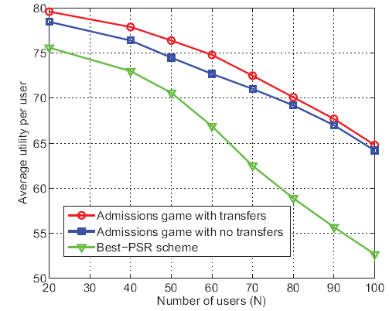
Average Utility per User
K=10 SCBSs, M=2 BSs
Vertical axis: R-factor
>20% improvement vs. Best-PSR scheme for N=100 users

Slide 96
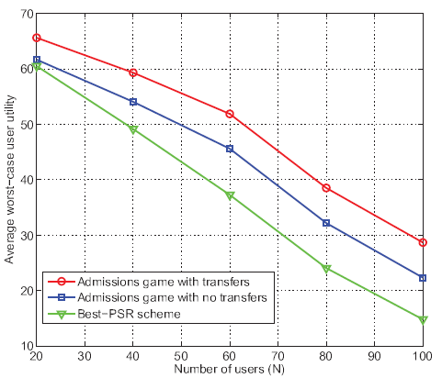
Worst-Case User Utility
K=10 SCBSs, M=2 BSs
Vertical axis: R-factor
>90% (>50%) improvement for the admissions game with transfers vs. Best-PSR scheme for N=100
Users with poor performance benefit from transfers as the network size increases

Slide 97
Resource allocation for cognitive networks with D2D communication: An evolutionary approach
  Peng Cheng, Lei Deng, Hui Yu, Youyun Xu, Hailong Wang, IEEE WCNC 2012.

Slide 98
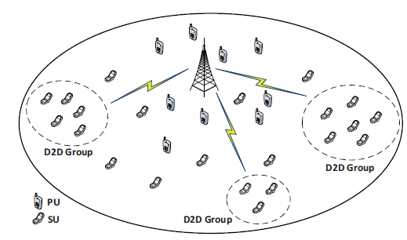
System Setup

Slide 99
Problem Statement (1)
D2D (non-overlapping) groups, uplink
Nodes in these groups can communicate with each other, either through the BS or through a D2D link
Each node chooses between these modes with a probability that changes over time

Slide 100

Problem Statement (2)
Utility for communicating through the BS=Rate - Power Consumption - Cost of Bandwidth
π is the cost of unit power
λ is the value of unit data
p1 is the price for using the bandwidth Bj

Slide 101

Problem Statement (3)
Utility for D2D communication
p2 is the cost of interference caused by D2D communication
Subscript i corresponds to the cellular user that uses this channel as well
The problem: Which mode and which power to choose?

Slide 102
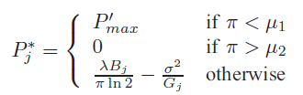
Power Control
Optimal power strategy for using BS mode
Optimal strategy for using D2D mode
  More complex analysis
  Boundary points/graphical solution

Slide 103
Mode Selection (1)
Use of evolutionary game theory/Evolutionary Stable Strategy (ESS)
Consider a large population all of whom are playing the same strategy. The strategy is called evolutionarily stable if any small mutation playing a different strategy would die out

Slide 104



Mode Selection (2)
via Ben Polak, Yale’s Open Courses
(a,a) and (b,b) are Nash Equilibria
Consider a population in which everyone was hard-wired to play b and consider a small e-mutation hard-wired to play a
Average payoff of b’s
Average payoff of a’s
A population that consists 100% of b's is not evolutionarily stable

Slide 105
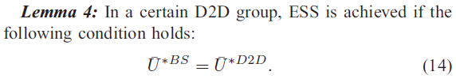
Mode Selection (3)

Slide 106
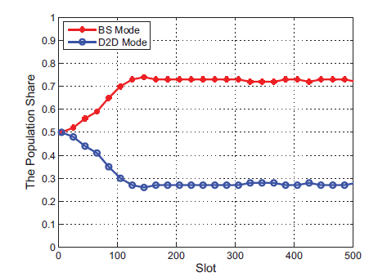
The Population Share
50 D2Ds
Initially, each node picks a mode with 0.5 probability
ESS corresponds to the point (0.73,0.27)
Convergence after ~100 slots

Slide 107

The Average Utilities
ESS is achieved according to the theorem
higher overall utility than pure BS/D2D mode

Slide 108
Energy-Efficient Resource Allocation for Device-to-Device Underlay Communication
  Feiran Wang, Chen Xu, Lingyang Song, Zhu Han, IEEE Transactions on Wireless Communications, 2015

Slide 109

System Setup
Red lines indicate interference

Slide 110
Problem Statement (1)
Single cell, one eNB, uplink
K cellular UEs and D D2D pairs (D < K)
K orthogonal channels
  each cellular UE occupies an orthogonal channel
  multiple D2D pairs can share the same channel simultaneously

Slide 111



Problem Statement (2)
The channel rate of k-th cellular UE is calculated as
The channel rate of D2D pair d is
The system sum rate during the uplink period

Slide 112
Problem Statement (3)
the utility function for each UEi
  the expected quantity of data transmission ri during the battery lifetime li
  a metric for energy efficiency

Slide 113
Combinatorial Resource Auction
A two-level combinatorial auction game, corresponding to joint channel allocation and power control
Channel allocation of the D2D UEs
  Prior allocation for cellular UEs is assumed
Then, powers of the cellular and the D2D UEs are jointly adjusted to mitigate the interference in the network

Slide 114



Combinatorial Auctions
Source: Vincent Conitzer, Lecture on “Auctions & Combinatorial Auctions”
Simultaneously for sale: , ,
bid 1
v(
) = $500
bid 2
v(
) = $700
bid 3
v(
) = $300

Slide 115


Channel Allocation (1)
D bidders (D2D pairs) submit bids for K channels
Multiple bidders can form a package that share the same channel
The first constraint ensures that a D2D pair can only be in one package
The second constraint guarantees that each D2D pair can be allocated one channel
Optimal assignment: NP-hard problem

Slide 116
Channel Allocation (2)
Multi-round iterative combinatorial auction for an approximation
The seller (eNB) sells the channel to the highest bidder
Bidders recalculate their utilities and resubmit offers
The auction process moves on until all the bidders obtain an item
The seller adjusts the auction results to improve the outcome
  The kicked bidder bids again for other channels

Slide 117

Power Control Game
Each player selects its power in
A Nash equilibrium exists in the power control game
The power control game has a unique equilibrium if
  constant circuit power consumption p0
  distributed scheme using best responses

Slide 118

Average Rate per UE with Number of D2D Pairs
100% higher data rates with D2D than with cellular
Performance for D2D pairs remain unchanged as the network size increases

Slide 119

Average UE Battery Lifetime with Number of D2D Pairs
25% longer battery lifetime with D2D

Slide 120
Power Control and Bargaining under Licensed Spectrum Sharing
V.G. Douros, “Incentives-Based Power Control in Wireless Networks of Autonomous Entities with Various Degrees of Cooperation,” Ph.D. Thesis, AUEB, 2014.

Slide 121
Motivation (1)
Small cell industry firsts
First launch | Sprint Wireless (US) | September 2007
First enterprise launch | Verizon Wireless (US) | January 2009
First public safety launch | TOT (Thailand) | March 2011
First standardized launch | Mosaic (US) | February 2012
First LTE femtocell | SK Telecom (South Korea) | June 2012
December 2012: FCC considers 3.5 GHz as the shared access small cells band
  Currently used by U.S. Navy radar operations
Data by Small Cell Forum

Slide 122



Motivation (2)
Why shared?
Why small cells?
What about interference?
  “We seek comment on […] mitigation techniques […] (3). The use of automatic power control […]” ☺
July 2014: Trials for licensed spectrum sharing for complementary LTE-Advanced

Slide 123
Challenge and Contributions
The challenge: Ensure that wireless operators can seamless coexist in licensed spectrum sharing scenarios
    Our contributions: Power control with bargaining for improvement of operators’ revenues
  Our joint power control and bargaining scheme outperforms both the NE without bargaining and classical pricing schemes in terms of revenue per operator and sum of revenues
  A simple set of bargaining strategies maximizes the social welfare for the case of 2 operators with lower communication overhead than pricing

Slide 124

System Model
N operators, 1 BS per operator, 1 MN per BS
Each operator:
  controls the power of its BS
  charges its MN per round based on the QoS
  aims at maximizing its revenue per round
Each device:
  will not change operator
  downloads various files
  pays more for better QoS without min./max. QoS requirements

Slide 125

Game Formulation
A non-cooperative game formulation
The game admits a unique Nash Equilibrium: All BSs transmit at P_{max}
Our work: Can we find a more efficient operating point?
Players | BSs/Operators
Strategy | Power P_{i} in [P_{min},P_{max}]
Utility | c_{i} Blog(1+SIR_{i})

Slide 126

Analysis for N Operators (1)
Red makes a “take it or leave it” offer to Black
“I give you o_{1,2} € to reduce your power M times”
Estimated revenue
NE revenue

Slide 127

Analysis for N Operators (2)
Black accepts the offer iff:
Win-win scenario
Key question: Are there cases that the maximum offer that red can make is larger than the minimum offer that black should receive?

Slide 128

Analysis for 2 Operators (1)
Theorem: Let $\frac{G_{11}}{G_{21}}=q$ and $\frac{G_{22}}{G_{12}}=r$ the ratios of the path gain coefficient of the associated BS to the path gain coefficient of the interfering BS.
  If M$≥\text{max}\left\{1,\frac{r}{q}\right\}$, then $o_{1,\text{max}}≥$ $o_{2,\text{min}}$
  If M$≥\text{max}\left\{1,\frac{q}{r}\right\}$, then $o_{2,\text{max}}≥$ $o_{1,\text{min}}$
Good news: We can always find a better operating point than the NE without bargaining

Slide 129
Analysis for 2 Operators (2)
Theorem: The maximum sum of revenues of the operators corresponds to one of the
following operating points: A₁=(P₁, P₂)=(P_{max}, P_{min}) or A₂=(P₁, P₂)=(P_{min}, P_{max}).
Better news: By asking for the maximum power reduction, the operators will reach to an agreement at either point A₁ or point A₂ and they will maximize the social welfare

Slide 130

Numerical Examples (1)
minimum offer
MN₁ BS₂
BS₁ MN₂
All these points are more efficient than the NE
limit
OP₁ offers
M=32
Step=1.15
q=$\frac{G_{11}}{G_{21}}=1$
r= $\frac{G_{22}}{G_{12}}=1$
Revenue
at the NE
Maximum offer
BargainingA1(2): Revenue of OP₁ (OP₂) when OP₁ makes offers

Slide 131
Numerical Examples (2)-
Sum of Revenues
BargainingA/B strictly outperforms NE and Pricing in terms of sum of revenues
BargainingB maximizes the social welfare
[Huang,06]

Slide 132
Agenda for Future Directions
N Operators
Minimum/maximum data rates
Coalitional game theory
  How to share their revenues?
  Shapley value, core
  Nash Bargaining Solution
  Communication overhead

Slide 133
Channel Access Competition in Device-to-Device Networks
  V.G. Douros, S. Toumpis, G.C. Polyzos, IWCMC 2014.

Slide 134
Challenge and Contributions
  The challenge: Seamless coexistence of autonomous devices that form a D2D network
  Our work: Channel access in linear/tree D2D networks
  When a node should send its data?
Contributions:
  We propose two distributed schemes with different level of cooperation that converge fast to a NE
  We analyze the structural properties of the NE
  We highlight the differences from typical scheduling approaches

Slide 135
Problem Description (1)
Each node in this linear D2D network either transmits to one of its neighbors or waits
Saturated unicast traffic, indifferent to which to transmit at
Node 3 transmits successfully to node 4 iff none of the red transmissions take place
If node 3 decides to transmit to node 4, then none of the green transmissions will succeed
1
2
3
4
5
6
1
2
3
4
5
6
Node 4 should neither transmit nor receive
Node 2 cannot receive from node 1
Node 4 cannot receive from node 5
Nodes 2 and 4 cannot transmit to node 3

Slide 136
Problem Description (2)
The problem: How can these autonomous nodes avoid collisions?
The (well-known) solution: maximal scheduling…
  is not enough/incentive-compatible ☹
We need to find equilibria!
1
2
3
1
2
3
1
2
3

Slide 137
Game Formulation
Players | Devices
Strategy | {Wait, Transmit to one of the |D| neighbors}
Payoff | Success T_{x}: 1-c Wait: 0 Fail T_{x}: -c
This is a special type of game called graphical game
Payoff depends on the strategy of 2-hop neighbors
We have also examined another payoff model with non-zero payoff for the receiver
Success T_{x} > Wait > Fail T_{x}
c: a small positive constant

Slide 138
On the Nash Equilibria (1)
How can we find a Nash Equilibrium (NE)?
We do not look for a particular NE; any NE is acceptable
The (well-known) solution: Apply a best response scheme…
  will not converge ☹
Our Scheme 1: A distributed iterative randomized scheme, where nodes exchange feedback in a 2-hop neighborhood to decide upon their new strategy
1
2
t1
1
2
t2
1
2
t3
1
2

Slide 139
On the Nash Equilibria (2)
Each node i has |D_{i}| neighbors and |D_{i}|+1 strategies. Each strategy is chosen with prob. 1/(|D_{i}|+1)
A successful transmission is repeated in the next round
Strategies that cannot be chosen increase the probability of Wait
1
2
3
4
5
1
2
3
4
5
t1
t2
1
2
3
4
5
t3
1
2
3
4
5
This is a NE! ☺

Slide 140
On the Nash Equilibria (3)
By studying the structure of the NE, we can identify strategy subvectors that are guaranteed to be part of a NE
We propose Scheme 2, a sophisticated scheme and show that it converges monotonically to a NE
t1
1
2
3
4
5
t2
1
2
3
4
5

Slide 141

On the Nash Equilibria (4)
1
2
N-1
R
N
…

Slide 142

On the Nash Equilibria (5)

Slide 143
On the Nash Equilibria (6)
Scheme 2: A successful transmission is repeated iff it is guaranteed that it will be part of a NE vector
Nodes exchange messages in a 3-hop neighborhood
Is this faster than Scheme 1?
1
2
3
4
5
t1
1
2
3
4
5
t2
1
2
3
4
5
Local NE
t3
1
2
3
4
5
This is a NE! ☺

Slide 144
Performance Evaluation (1)
Scheme 2 outperforms Scheme 1
Even in big D2D networks, convergence to a NE is very fast
This holds in tree
D2D networks
as well

Slide 145
Performance Evaluation (2)
Good news: Convergence to a NE for Scheme 2 is ~ proportional to the logarithm of the number of nodes of the network
Better news: In <10 rounds, most nodes converge to a local NE

Slide 146

Agenda for Future Directions
General D2D networks
Repeated non-cooperative games
  Enforce cooperation by repetition
  Punish players that deviate from cooperation
Price of Anarchy, Price of Stability…
  Even in big perfect tree D2D networks:

Slide 147
General Issues
Dynamic settings
  Mobility, handover
Complexity analysis vs. practical implementation
What if the players cheat?

Slide 148
Conclusions
Radio Resource Management remains a key issue towards the 5G era
  Small cells and D2D networks are key 5G “players”
Game theory is a powerful framework to model the interactions of the devices in such heterogeneous networks
  Classic approaches/ideas should and could be revisited towards this direction

Slide 149
Pointers to Selected References (1)
Books
  Z. Han, D. Niyato, W. Saad, T. Basar, A. Hjorungnes, “Game theory in wireless and communication networks: theory, models, and applications,” Cambridge University Press, 2011.
  Z. Han, K. J. Ray Liu, “Resource allocation for wireless networks: basics, techniques, and applications,” Cambridge University Press, 2008.
  T. Q. S. Quek, G. de la Roche, I. Güvenç, M. Kountouris, “Small cell networks: Deployment, PHY techniques, and resource management,” Cambridge University Press, 2013.
Websites
  Device-to-device communications, http://wireless.pku.edu.cn/home/songly/d2d.html
  Small cell forum, http://www.smallcellforum.org/

Slide 150
Pointers to Selected References (2)
Surveys & Tutorials
  S. Lasaulce, M. Debbah, E. Altman, “Methodologies for analyzing equilibria in wireless games,” IEEE Signal Processing Magazine, 2009.
  A. Asadi, Q. Wang, V. Mancuso, “A Survey on Device-to-Device Communication in Cellular Networks,” IEEE Communications Surveys & Tutorials, 2014.
  L. Song, D. Niyato, Z. Han, E. Hossain, “Game-theoretic resource allocation methods for device-to-device communication,” IEEE Wireless Communications Magazine, 2014.
  M.N. Tehrani, M. Uysal, H. Yanikomeroglu, “Device-to-device communication in 5G cellular networks: challenges, solutions, and future directions,” IEEE Communications Magazine, 2014.

Slide 151
Pointers to Selected References (2)
Surveys & Tutorials (continued)
  F. Mhiria, S. Kaouthar, R. Bouallegue, “A survey on interference management techniques in femtocell self-organizing networks,” Elsevier Journal of Network and Computer Applications, 2013.
  T. Zahir, K. Arshad, A. Nakata, K. Moessner, “Interference management in femtocells,” IEEE Communications Surveys & Tutorials, 2013.
  J. G. Andrews, H. Claussen, M. Dohler, S. Rangan, M.C. Reed, “Femtocells: Past, present, and future,” IEEE Journal on Selected Areas in Communications, 2012.
  J. G. Andrews, S. Buzzi, W. Choi, S. Hanly, A. Lozano, A.C. Soong, J.C. Zhang, “What Will 5G Be?,” IEEE Journal on Selected Areas in Communications, 2014.

Slide 152
☺ Köszönöm! ☺
Vaggelis G. Douros and George C. Polyzos
Mobile Multimedia Laboratory
Department of Informatics
School of Information Sciences and Technology
Athens University of Economics and Business
{douros,polyzos}@aueb.gr
http://mm.aueb.gr

